Slide 1
this is topic
this is subtopic
this is second subtopic

Slide 2
this is subtopic
this is subtopic

Slide 3
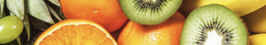

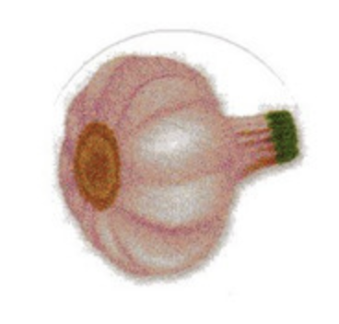
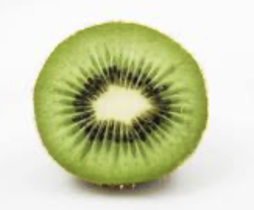

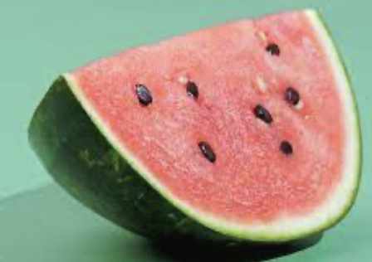

fruits
vegetables

Slide 4
fruits
vegetables

